Slide 1
Telecommunications Business Case
Juan Pablo Fernandez

Slide 2
Problem statement
A telecommunications company implemented a promotion to boost its landline sales. The promotion offered a 50% discount on calls to 10 destinations of the customer's choice. The company hypothesized that by reducing the price of calls to 10 specific numbers, customers would increase their landline usage and potentially make more calls to non-discounted numbers. The promotion was rolled out in the second week of July to 130 customers, who were informed about the discount for their selected 10 numbers.
What was the impact of this strategy?
Variables:
id: unique customer identifier
may: monthly bill in dollars for each customer in May 2014
august: monthly bill in dollars for each customer in August 2014

Slide 3
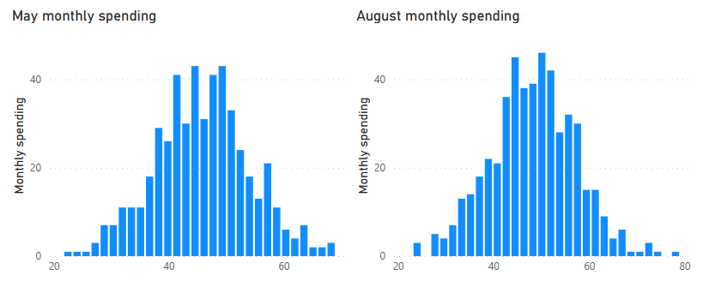
Data Analysis
Data from both months exhibited a normal distribution.
The mean for May was 46.59, and the mean for August was 49.26.
The t-test revealed a statistically significant difference between the two means at the 95% confidence level.
Conclusion: the promotion was effective in increasing the company's revenue.

Slide 4
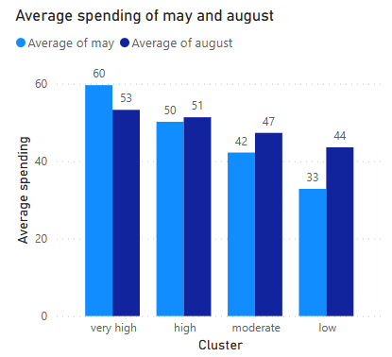
Cluster analysis
4 groups were identified based on the monthly spending of each client in the sample.
The Wilcoxon test revealed a statistically significant difference between the two means in the four groups at the 95% confidence level.
Monthly spending increased in all groups except for the “very high” spending group.
Monthly spending increased more in the lower spending groups and less in the high spending group.
Conclusion: Although the promotion increased monthly spending at a global level, it decreased monthly spending of the “very high” spending group. This may be due to the fact that the 'very high' group tends to concentrate the majority of their calls on fewer than 10 numbers, suggesting that for this group, the promotion essentially served as a discount on their usual calling habits.
Recommendation: Perform a customer segmentation and only offer the discount to the lower spending customers.

